Slide 1
Robust Resume Maker
Sibi Chakravarthy Ramesh
Balaji Natarajan
Bharath Kumar Natesan Arumugam
Lakshmi Nikitha Kona

Slide 2
Introduction
Our application generates an intelligent resume from the different social networking sites such as LinkedIn, Facebook and Code Wars.
Once the user logs in, our application will access all his details and update the resume.
At the end, you can upload your resume which will be reviewed by admin.

Slide 3
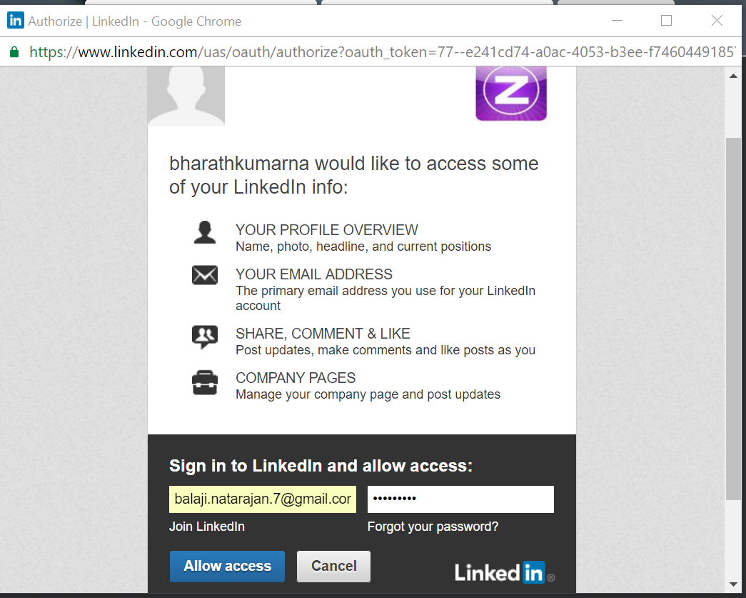
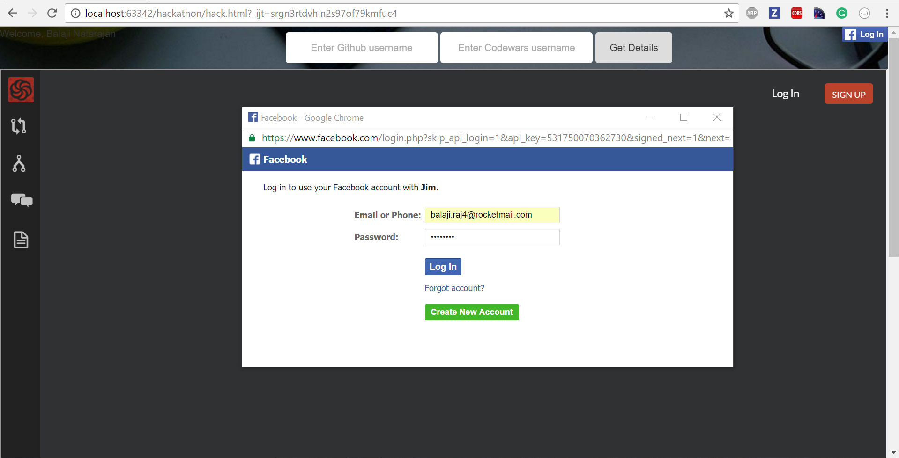
Log in with LinkedIn & Facebook
The user is asked to login with Facebook and LinkedIn

Slide 4
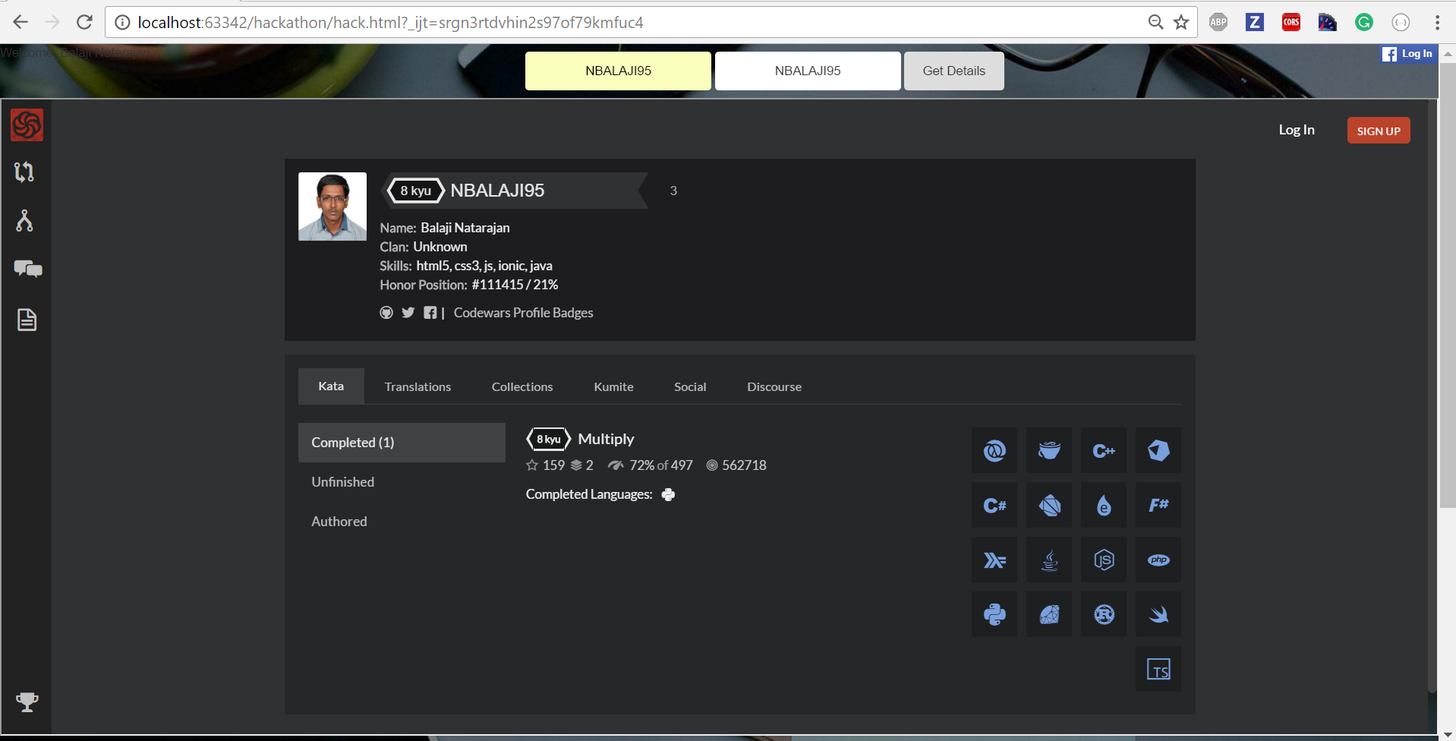
After entering GitHub & Codewars username

Slide 5
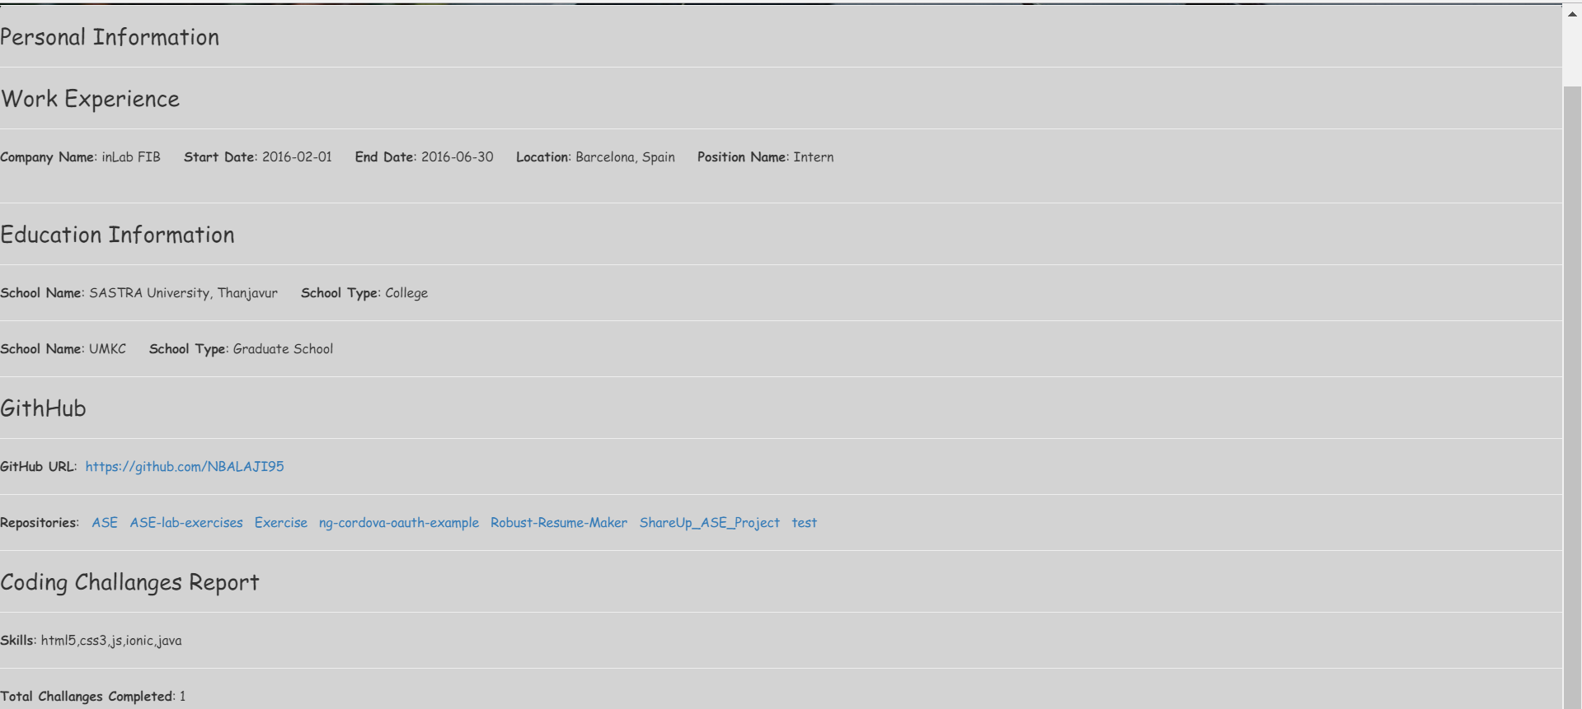
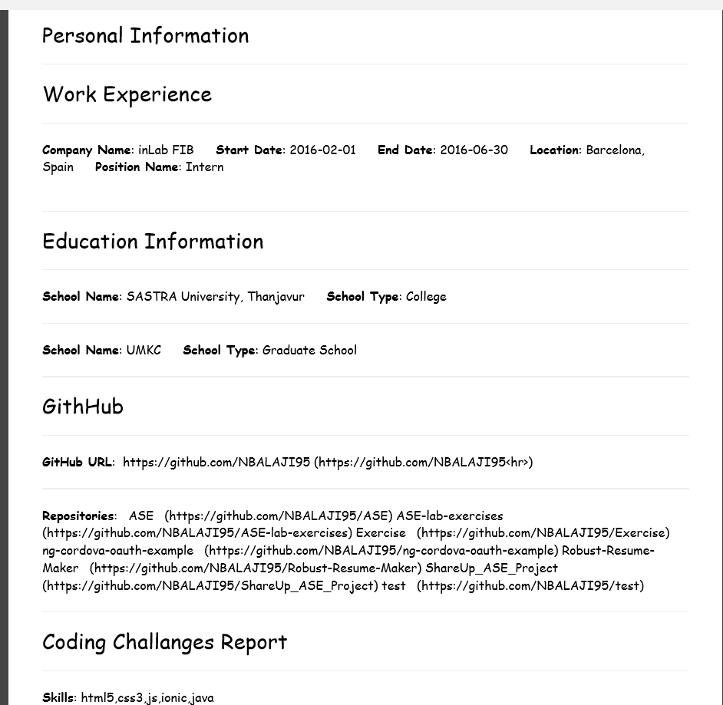
Resume and PDF Generation

Slide 6
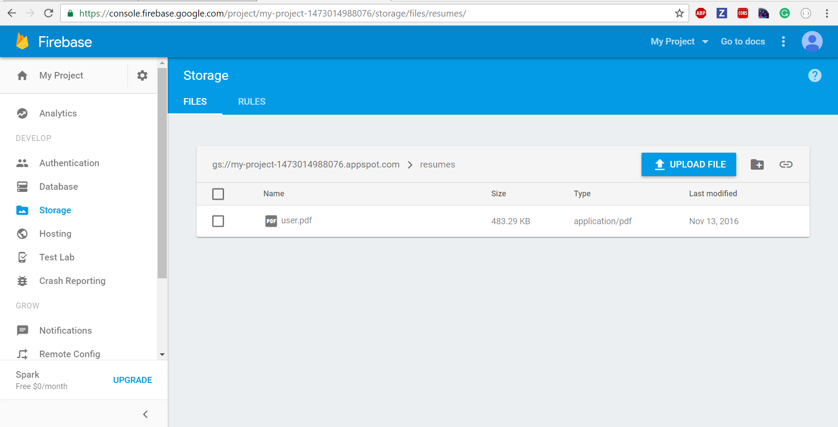
Firebase – Admin console
Once the resume is downloaded the user can upload the pdf and that is
Stored in the firebase and admin can keep track of it.

